Slide 1

Aircraft Engine Predictive Maintenance Using Machine Learning and Clustering
PRESENTED BY:
M.AKSHITHA
BATCH NO:456

Slide 2
AGENDA
Introduction
Crisp-ML(Q) Methodology
Business Problem
Dataset Overview
Data Preprocessing
Model Building
Model Evaluation
K-Fold cross validation
Hyper parameter Tuning
Clustering
Model Deployment
Challenges Faced
Recommendations
Conclusion

Slide 3
INTRODUCTION
Aircraft engines generate large amounts of sensor data during operation, and monitoring these sensors is essential for ensuring safety, reliability, and maintenance efficiency. Traditional maintenance methods often rely on fixed schedules, which may lead to unnecessary servicing or unexpected engine failures.
This project focuses on developing a Predictive Maintenance System for Aircraft Engines using machine learning techniques. The system analyzes multivariate sensor data collected from aircraft engines over multiple operational cycles to identify engine health conditions and degradation patterns.

Slide 4
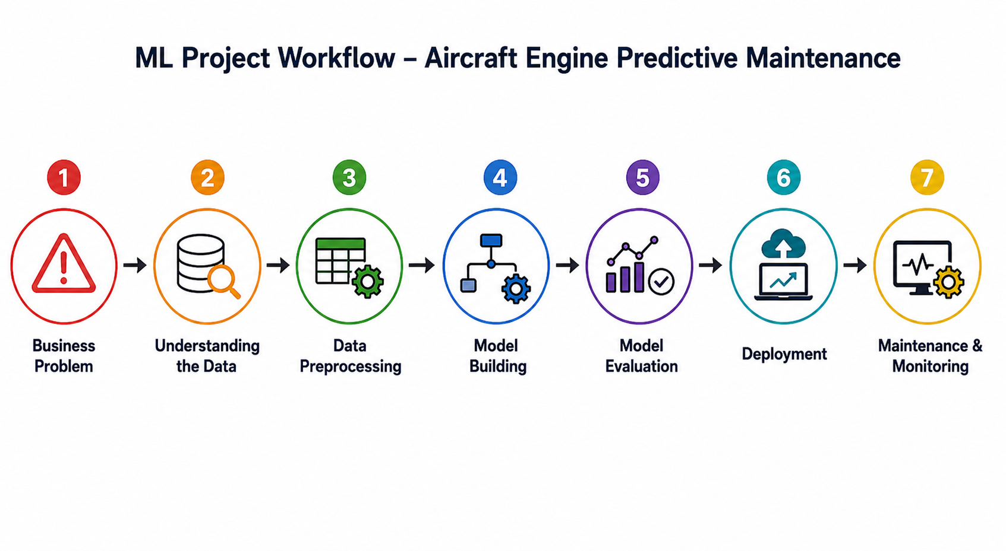

Slide 5
BUSINESS PROBLEM
Aircraft engines are critical and expensive components that operate under extreme conditions. Unexpected engine failures can lead to:
Flight delays
High maintenance costs
Operational downtime
Passenger safety risks
Financial losses for airlines
Modern aircraft engines generate continuous sensor readings during every operational cycle. However, airlines often struggle to convert this massive sensor data into actionable maintenance decisions.

Slide 6
OBJECTIVE
The objective of this project is to develop a Predictive maintenance system that can:
Monitor aircraft engine health continuously
Detect degradation patterns early
Identify critical engine conditions
Generate maintenance alerts automatically
Support condition-based maintenance decisions

Slide 7
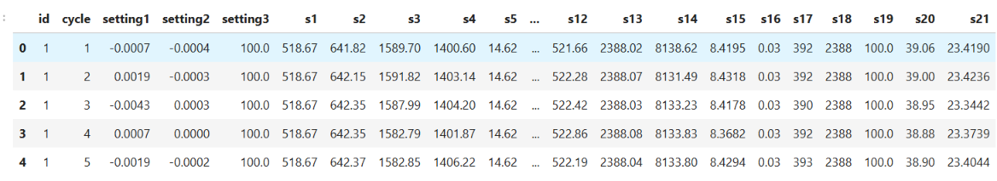
Data Understanding
Id-Unique engine identifier
Cycle-Number of operational cycles completed by the engine
Setting-Operational settings under which the engine is running
S1-s21-Sensor readings collected from different engine components

Slide 8
Data Preprocessing
The aircraft engine dataset was prepared for machine learning by selecting relevant sensor and operational features.
The dataset did not contain missing values or duplicate records, no data cleaning was required.
Numerical feature preprocessing was performed using StandardScaler to normalize the sensor values and PowerTransformer to reduce skewness and improve data distribution.
A preprocessing pipeline and ColumnTransformer were used to apply the transformations efficiently before training the machine learning models.

Slide 9
Feature Engineering
Feature Engineering was performed to create meaningful features that improve predictive maintenance analysis and engine health monitoring.
Remaining Useful Life (RUL): Calculated by subtracting the current engine cycle from the maximum cycle of each engine to estimate the remaining operational life.
Health State: Generated using KMeans clustering to classify engines into Healthy, Warning, and Critical conditions based on sensor behavior.
Alert Feature: Created based on the predicted health state to generate maintenance recommendations such as Normal Operation, Inspection Required, and Immediate Maintenance.

Slide 10
MODEL BUILDING
The model building process started by creating the feature matrix (X) and target variable (y), where the target was the Remaining Useful Life (RUL) of the aircraft engine. The dataset was divided into training and testing sets for model evaluation. A preprocessing pipeline was developed using StandardScaler, PowerTransformer, and ColumnTransformer to normalize and transform the numerical sensor features.
Multiple machine learning regression models such as
Linear Regression,
Random Forest Regressor,
Support Vector Regressor (SVR),
XGBoost Regressor

Slide 11
Model Evaluation
Model Evaluation is the process of assessing the performance of Machine Learning models to determine how accurately they predict the Remaining Useful Life (RUL) and health condition of aircraft engines. It helps in comparing different regression models and selecting the most accurate and reliable model for predictive maintenance.
For this predictive maintenance problem, the following evaluation metrics were used:
R² Score
Mean Squared Error (MSE)
Mean Absolute Error (MAE)

Slide 12
MODEL PERFORMANCE COMPARISION
MODEL | R2 SCORE | MSE | MAE
Linear Regression | 0.76 | 40.78 | 4.89
Decision Tree | 0.6343 | 32.51 | 4.31
KNN Regressor | 0.6265 | 33.21 | 4.51
SVR | 0.83 | 25.72 | 4.00
Random Forest | 0.83 | 17.10 | 3.3
XGBoost | 0.84 | 16.46 | 3.21

Slide 13
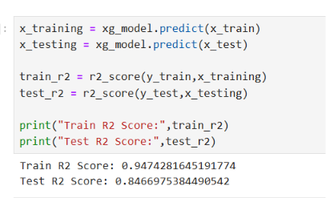
Checking Overfit Issue

Slide 14

Cross Validation
Cross Validation is a technique used to evaluate the stability and reliability of a machine learning model by testing it on different subsets of the dataset. In this project, K-Fold Cross Validation was applied with 5 splits to improve model generalization and reduce overfitting. The average cross-validation score obtained for the XGBoost model was approximately 0.85, indicating good predictive performance and model stability.

Slide 15
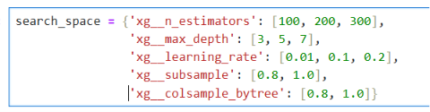
Hyperparameter Tuning
Hyperparameter Tuning was performed to optimize the performance of the XGBoost Regressor. RandomizedSearchCV was used to search for the best combination of model parameters. Parameters such as number of estimators, maximum depth, learning rate, subsample, and column sample by tree were optimized. After tuning, the XGBoost model achieved improved accuracy and better prediction performance, making it the final selected model for predictive maintenance and Remaining Useful Life prediction.

Slide 16
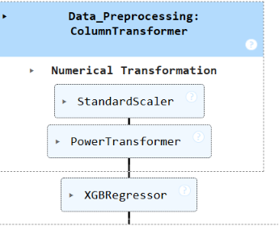
Workflow of Model

Slide 17
MODEL PERFORMANCE
1. High R² Score (0.85)
2. Low MAE (3.21)
3. Lower MSE (16.46)
XGBoost was selected as the final model because it achieved the best performance across all evaluation metrics. It has an R² score of around 0.85, indicating strong predictive capability

Slide 18
Clustering
Clustering is an unsupervised machine learning technique used to group similar data points based on their patterns and characteristics. In this project, KMeans clustering was applied on aircraft engine sensor data to identify hidden degradation patterns and classify engine conditions into different health states such as Healthy, Warning, and Critical. PCA was used before clustering to reduce dimensionality and improve cluster visualization. Clustering helped in understanding engine degradation behavior and generating maintenance alerts for predictive maintenance.

Slide 19
Model Deployment
For deployment Used Streamlit for Building a simple UI where users can input data and get predictions.
Pushing Streamlit app to Hugging Face Spaces for free hosting
Hugging Face: Aircraft Engine Prediction - a Hugging Face Space by AkshithaReddyManne

Slide 20
RECOMMENDATIONS
Implement real-time engine monitoring systems using sensor data
Perform predictive maintenance instead of fixed scheduled maintenance
Continuously monitor critical sensor values for early fault detection
Use automated alert systems for maintenance decision support

Slide 21
CHALLENGES
Identifying meaningful degradation patterns from noisy sensor readings
Managing large time-series datasets efficiently
Selecting the most important sensor features
Handling high-dimensional sensor data from multiple engines
.

Slide 22
CONCLUSION
This project developed an AI-based predictive maintenance system for aircraft engines using machine learning and KMeans clustering techniques. The system predicts Remaining Useful Life (RUL), identifies engine health conditions, and classifies engines into Healthy, Warning, and Critical clusters using sensor data. XGBoost achieved the best prediction performance, and the Streamlit dashboard provides real-time monitoring, visualization, clustering analysis, and maintenance alerts for intelligent decision-making.

Slide 23

THANK YOU

